Slide 1
2023 Capital Improvement Program
State Public Works Board
August 24, 2022

Slide 2
DMV Summary List of Projects
Project Number | Location | Project Name
23020 | Las Vegas | Construction of Silverado Ranch Facility
23022 | Las Vegas | Upgrade to Flamingo Warehouse Air Conditioning
23023 | Carson City | Remodel Customer Counter Millwork and Install Exterior Self Service Kiosk
23030 | Las Vegas | Construct Secure Parking Area for State Owned Vehicles
23035 | Carson City | Install License Plate Factory Emergency Generator

Slide 3
Construction of Silverado Ranch Facility

Slide 4
Construction of Silverado Ranch Facility
Notes:
This project is the continuation of 21-P06 for the construction of a full-service DMV facility with Commercial Driver’s License services.

Slide 5
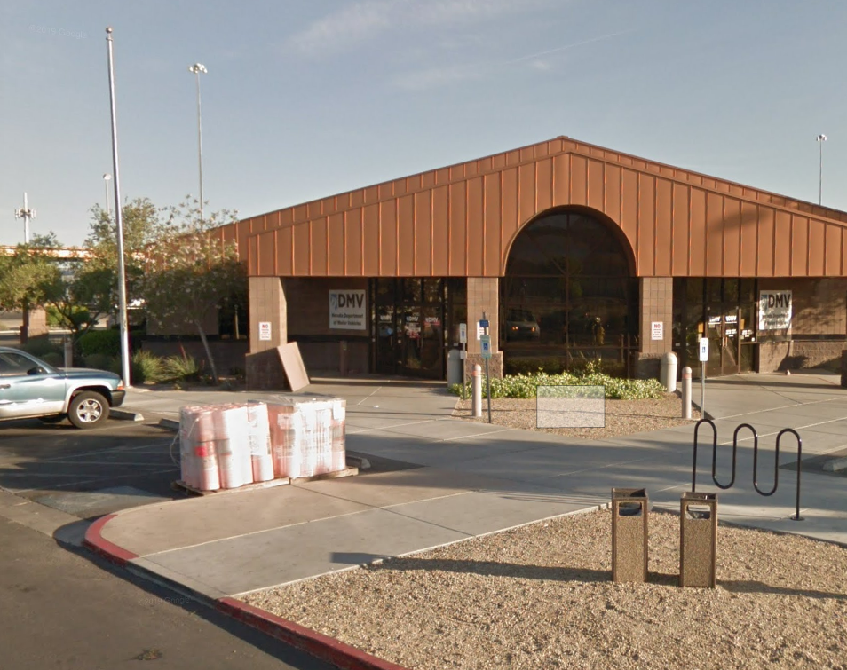
Why is a new full-service facility needed?
The Donovan Express CDL facility was built in 1995.
The Donovan facility is in an industrial area of North Las Vegas and customers complain about the poor access to the site.
Due to population growth, the facility cannot accommodate the increase of walk-in customers. Lines form outside the building in +100ºF heat.
The classroom for the third-party program training is too small.
Restrooms, offices, customer counters and the breakroom need extensive refurbishment.
Notes:
The Donovan Express CDL facility was constructed in 1995.
The Donovan facility is in an industrial area of North Las Vegas. Access for the major population base is poor and is subject to numerous acts of vandalism. Customer and state employee safety is a concern as the location is frequented by drug addicts and has amassed a large contingent of homeless individuals around the perimeter of the building and CDL test course.
The building is showing its age and all areas are requiring a complete overhaul at this point.
The third-party program office received additional manning authorization and was eventually backfilled in October 2019. The equipment and furniture for the additional employees to use made the third-party program office overcrowded, thus eliminating the space to conduct 40-hour certification classes. The typical class size has between 6 to 8 attendees. Both FMCSA and AAMVA directives mandate all third-party participants to successfully pass the certification class. Having adequate room to administer classroom training is a crucial requirement to meet.

Slide 6
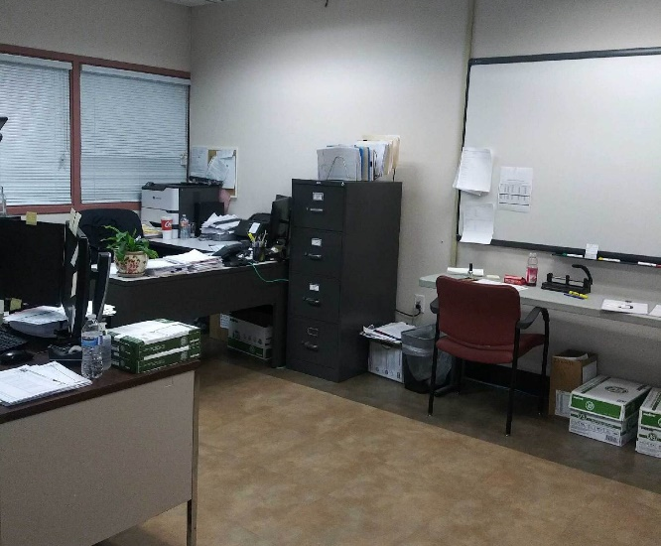
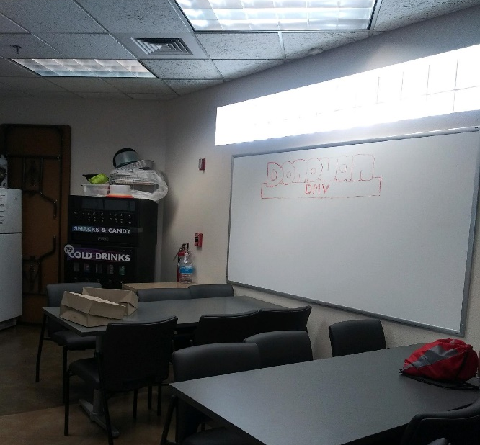
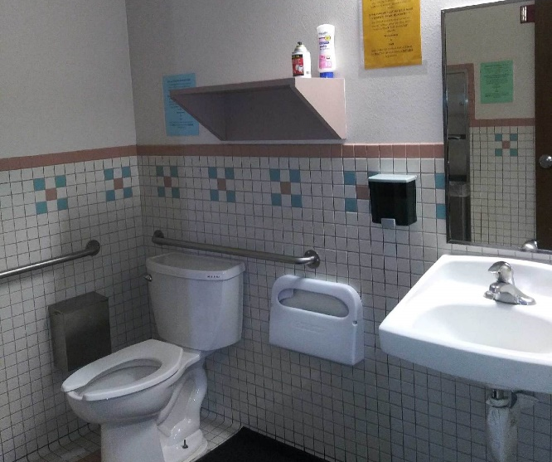
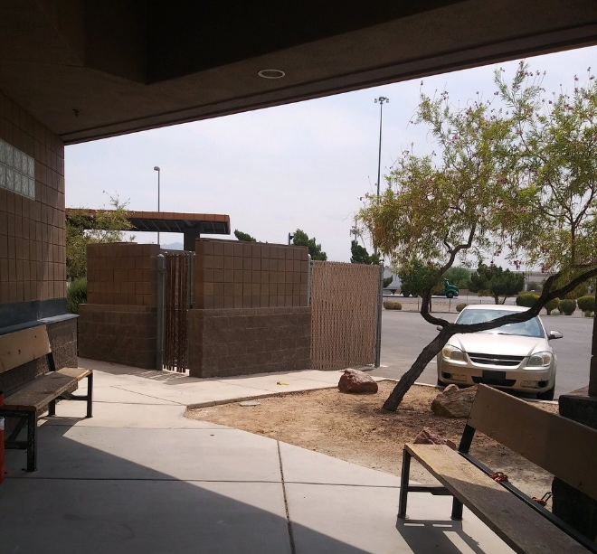
Some of the Problem Areas at Donovan

Slide 7
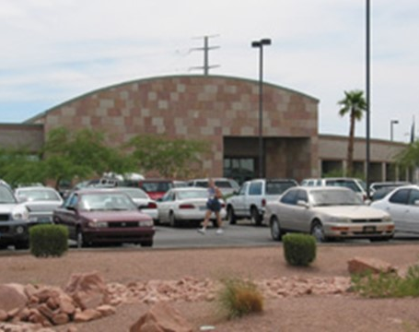
Why is a new full-service facility needed?
The Henderson DMV facility was constructed in 1997.
The property on which the facility is located does not allow the potential for growth.
The parking lot is too small which causes customer frustration.
The customer counters are not ADA compliant and were built when there was less electronic equipment used by staff to conduct transactions.
Due to the customer lobby shape, customers cross over each other when navigating their way through the building.
Other areas of the building, such as restrooms, offices, lighting, architectural aesthetics, need extensive refurbishment.
Notes:
The Donovan Express CDL facility was constructed in 1995.
The Donovan facility is in an industrial area of North Las Vegas. Access for the major population base is poor and is subject to numerous acts of vandalism. Customer and state employee safety is a concern as the location is frequented by drug addicts and has amassed a large contingent of homeless individuals around the perimeter of the building and CDL test course.
The building is showing its age and all areas are requiring a complete overhaul at this point.
The third-party program office received additional manning authorization and was eventually backfilled in October 2019. The equipment and furniture for the additional employees to use made the third-party program office overcrowded, thus eliminating the space to conduct 40-hour certification classes. The typical class size has between 6 to 8 attendees. Both FMCSA and AAMVA directives mandate all third-party participants to successfully pass the certification class. Having adequate room to administer classroom training is a crucial requirement to meet.

Slide 8
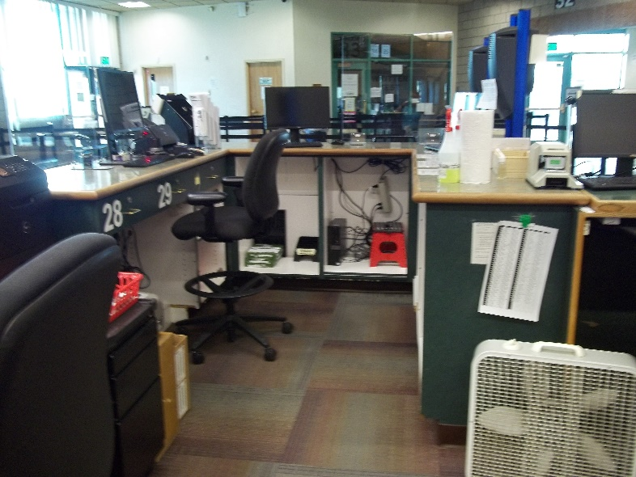
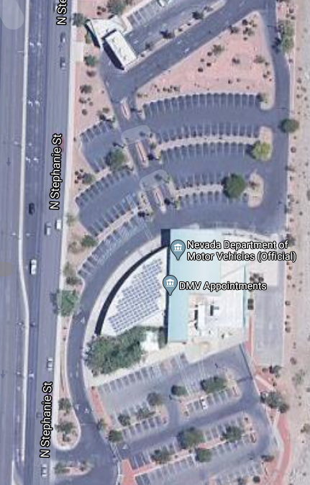
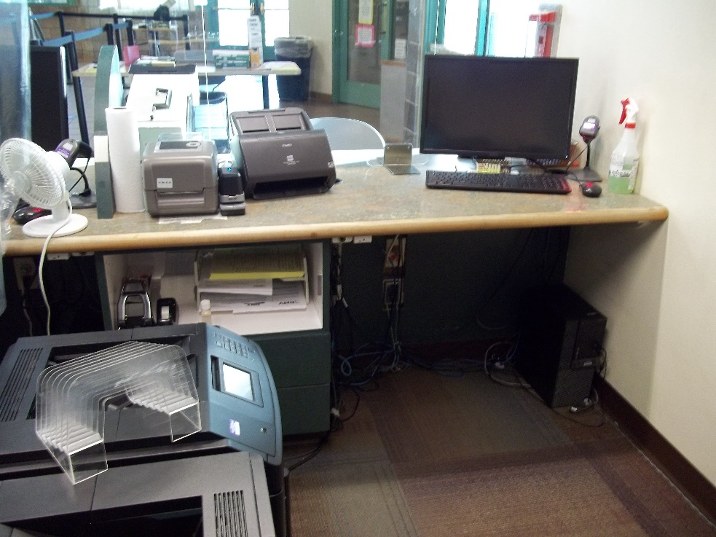
Some of the Problem Areas in Henderson

Slide 9
Clark County Population
Notes:
The UNLV Center for Business and Economic Research provided these statistics on Clark County’s growth:
The Clark County population when the Henderson DMV opened in 1997 was 1.1 million people
The projected population of Clark County in 2030 is 2.7 million, which is more than double the population when the building was first constructed

Slide 10
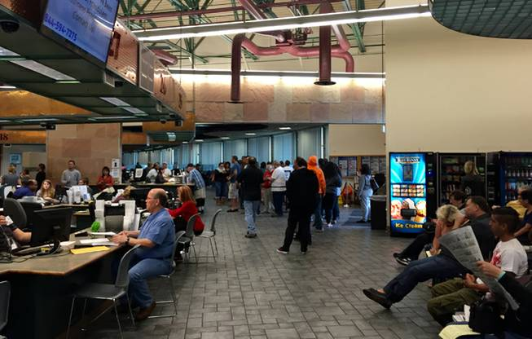
Relevant Data in Numbers
DMV Henderson Location
Avg. Customer Wait Time (in minutes) | 54
Customer Service Windows Available | 38
Employees on Location | 122
Average Customers Served per Day | 1,300
Total Parking Spaces Available | 259
Notes:
The Henderson office currently has 38 customer service windows with an average wait time of 54 minutes. The inability to swiftly serve this customer base is not only seen in the long lines, and long wait times (average 54 minutes) at the Henderson Office but is also seen by the increasingly large number of Las Vegas customers who travel to Mesquite, Pahrump and Laughlin to conduct their business. This in turn is creating longer lines and longer wait times for the customer base at these other offices. The continuing negative impact to our customer base is only going to worsen given the growth statistics mentioned in the previous slide.
The current facility has 259 parking places for customers and staff to serve an average of 1,300 customers per day. 82 of those parking spaces are for 122 staff. Only nine parking places are designated for disabled customers.
ASD Office Capacity: The Administrative Services staff work in an office that will only accommodate two to three staff shoulder to shoulder. This leads to delays at the end of the day, as it only allows two to three of the 45 to 50 technicians to cash out at one time. This increases overtime costs.
Restroom Facilities: Employee restroom facilities consist of one women’s restroom with six stalls and one men’s restroom with two stalls and one urinal. These facilities are wholly inadequate to meet the needs of the staff. I imagine you get the picture.
Breakroom: The employee breakroom can accommodate no more than 12 staff at one time. This is a pre COVID-19 number and today only half can use the breakroom due to social distancing. Appliances used are old and the electrical outlets need to rewired as there are constant circuit breaker trips.
Outside Break Area: The outside break area available to the DMV employees is an open-fenced patio that resembles a cage in a zoo. The customers can walk past the employees in the outside break area and ask DMV-related questions. This means DMV staff cannot get away from the customers to truly enjoy their well-deserved breaks. Customers have also tried to gain access to the building through the outside break area which poses a security risk.
Parking: Parking was touched on previously, but its impact is heavy on both the public and employees alike. With a total of 259 parking spaces available, 159 staff members and hundreds of customers at any given time, staff members often do not leave the building to enjoy their lunch break offsite for fear they will not be able to get parking when they return. If they do choose to leave the building, they must allow themselves the extra time needed to circle the parking lot seeking a parking space, and when one is not found, they park their cars offsite and walk to the DMV building – all within their allotted one-hour lunch break. Returning late from their scheduled lunch can subject an employee to disciplinary action. Coupling this challenge with the lack of adequate breakroom space, the staff at the DMV are left with very little accommodations to enjoy their hard-earned breaks.

Slide 11
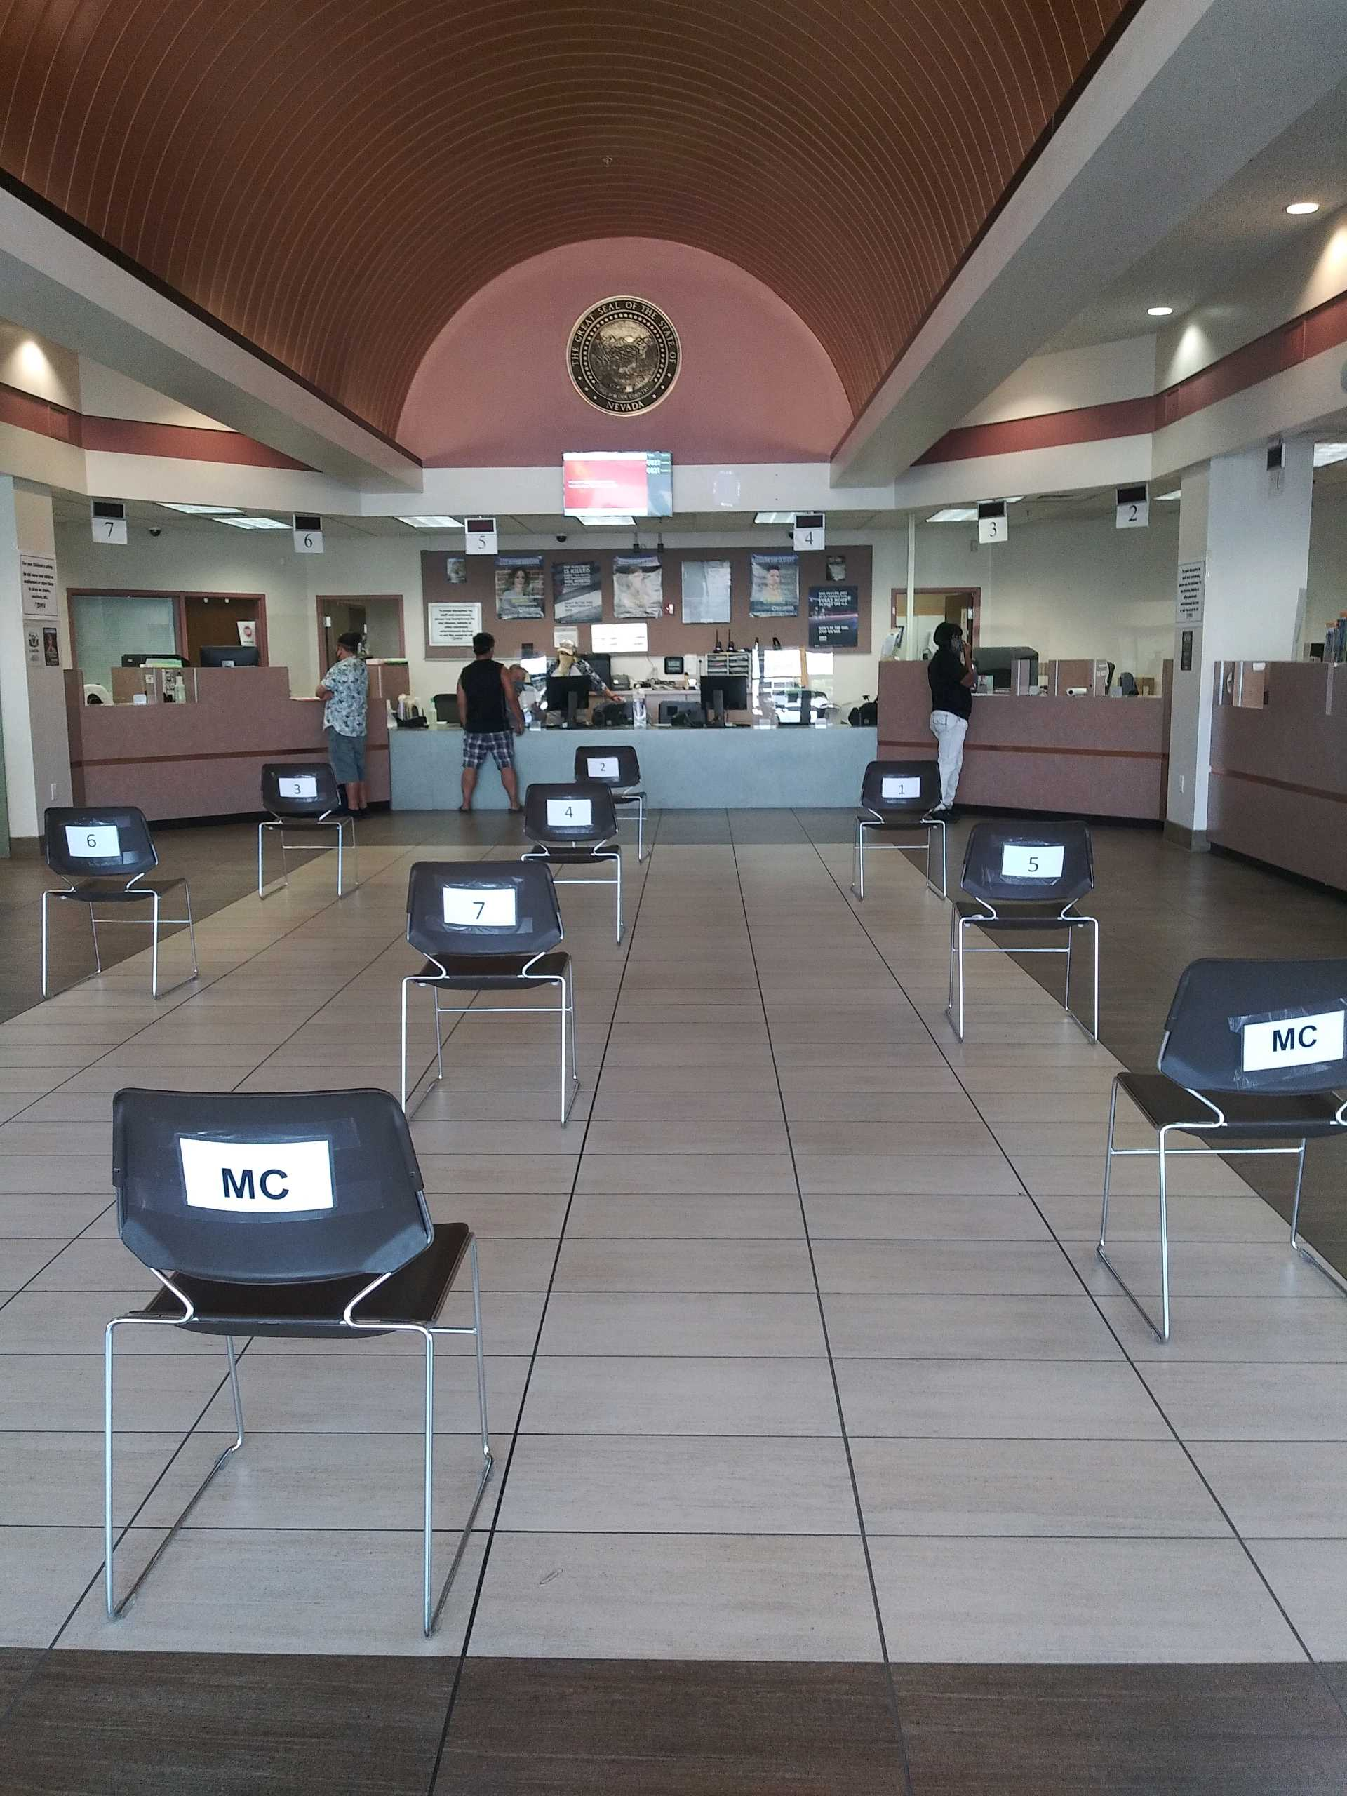
Relevant Data in Numbers
DMV Donovan Location
Avg. Customer Wait Time (in minutes) | 40
Customer Service Windows Available | 9
Employees on Location | 21
Average Customers Served per Day | 285
Total Parking Spaces Available | 94
Notes:
The Donovan office currently has nine customer service windows and three information desks. Two of the windows serve Motor Carrier customers. Again, the inability to swiftly serve CDL customers creates long lines, and long wait times.
Restroom Facilities: Employee restroom facilities consist of two single restrooms which are shared by both men and women. This is unacceptable and leaves the State liable for any inappropriate actions which may occur.
Breakroom: The employee breakroom needs refurbishment and is original to the building. It has two tables with six chairs. This is a pre-COVID-19 number and today only half can use the breakroom due to social distancing. Appliances used are old and need to be replaced. As the restrooms are adjacent to the breakroom, noises are transferred through the walls.
Outside Break Area: The outside break area consists of two picnic benches which are out in the open, adjacent to the building staff entrance. Security is lacking for employees and they are unable to distance themselves from customers and vagrants.

Slide 12

It’s time…
To meet the growing demand of the Clark County population.
To reduce customer and employee frustration.
For a new Southern Nevada DMV Services Center.

Slide 13
Southern Nevada Services Center
A Combined DMV, Emissions and Commercial Driver’s License Facility
Notes:
Combining the current DMV facilities in Henderson and the Donovan Commercial Driver’s License (CDL) office into one new service center in South Las Vegas aligns with the Governor’s Strategic Plan of “Keep Nevada Strong.” The new Service Center would help us provide excellent customer service, improve the efficiency of operations and service delivery, and help recruit and retain a mission-ready workforce.

Slide 14
A One-Stop Center would Reduce Confusion and Frustration while Improving the Customer Experience
Notes:
The design for this facility will be based on the design we did for our South Reno office.

Slide 15
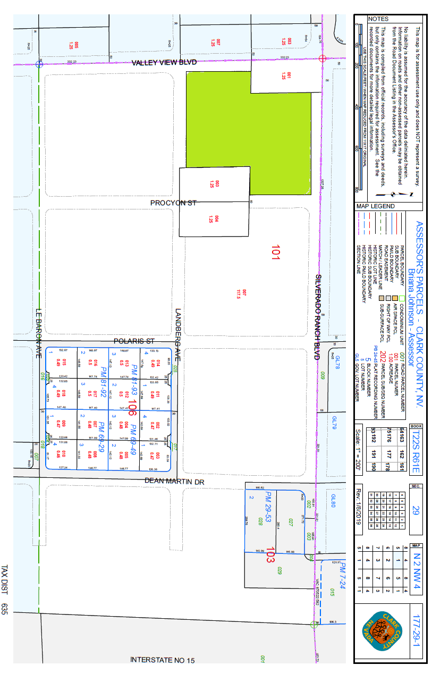
Location and Background
It is on a 20-acre property leased through the State Lands Office from the Federal BLM.
Advanced planning and a schematic design were already completed by Tate Snyder Kimsey.
The plan was approved as part of CIP 11-E04.
It is NOT a General Fund project.
The location is not in a residential zone and is easily accessible via I-15.

Slide 16
Parking and Access
If approved, the new Southern Nevada DMV Service Center would offer enough parking to accommodate the needs of the staff and customers including:
350 parking spaces for customers, including parking spaces for EVs
134 spaces for employees
23 designated disabled parking spaces
Notes:
The new service center will alleviate previous parking issues by providing approximately 350 parking spaces for customers, 134 spaces for employees, and 23 spaces designated for disabled customers.

Slide 17
Increasing Capacity and Impact
60 service windows available to serve customers, decreasing wait times and 7 Information windows
Secure work conditions and breakroom for employees
Improved restroom facilities to accommodate customers/staff
Improved ADA and safety features
Notes:
Moving forward with the new South Las Vegas Service Center will increase the capacity at this facility from 38 to 49 service windows allowing our customer wait times to be significantly reduced. A resulting direct benefit will not only be seen in the efficient service at the new Las Vegas office but also far less customers traveling to offices in other parts of Southern Nevada to conduct their business.

Slide 18
Rendering of the CDL Customer Lobby

Slide 19
Flamingo Warehouse Air Conditioning Upgrade

Slide 20
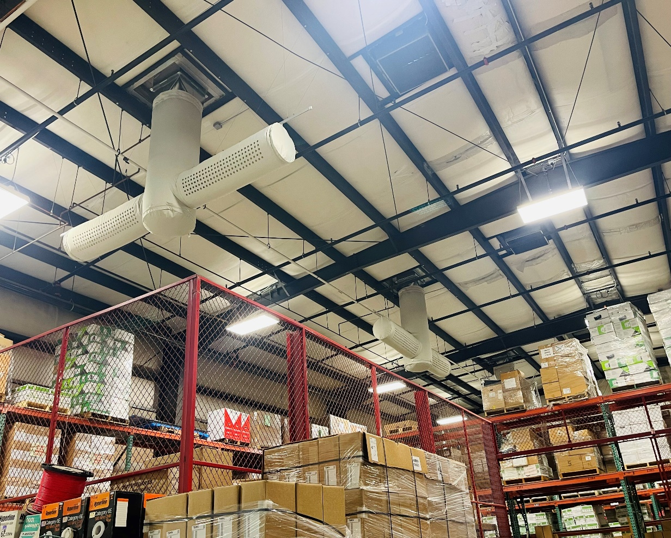
Why is an air conditioning upgrade needed?
During the summer months, temperatures in the Flamingo Warehouse have become intolerable.
The existing swamp coolers are not decreasing the temperatures to a level where it is comfortable for staff to work within the warehouse area for dispatching and receiving goods.
Due to the humidifying effect of the evaporative coolers, stored archived materials are not being stored in ideal temperatures and moisture levels are deteriorating paper products and forms. Swamp coolers drop the interior temperature by 7ºF at best.
The hotter temperatures are affecting the way DMV warehouse staff operate. Earlier work start times are the norm as working in the warehouse after noon is uncomfortable.
There is a health concern with the buildup of mold in the coolers.
This project will improve the working environment for staff and help with employee retention.

Slide 21
Carson City DMV Customer Counter Remodel and Exterior Self-Service Kiosk Installation

Slide 22
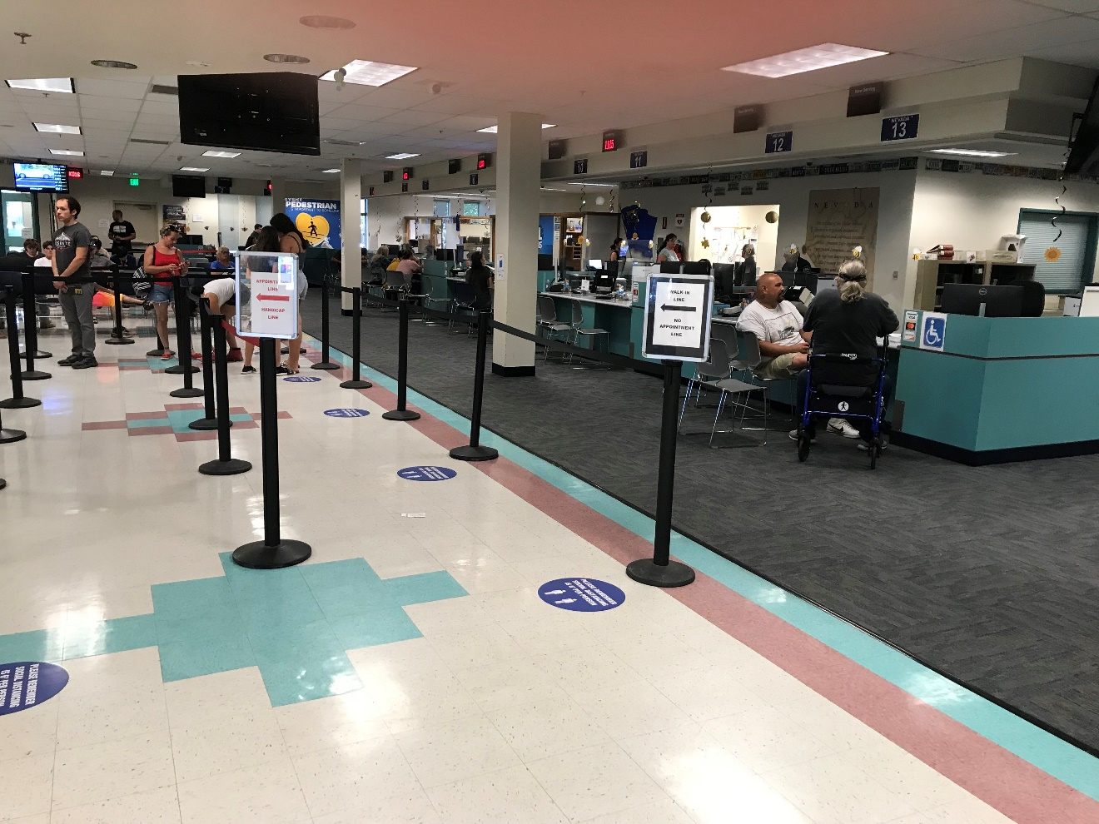
Why are the Carson City upgrades needed?
The existing customer counters are not fully ADA compliant and accommodation for those with accessibility needs must be provided in a different part of the lobby area.
The current casework is showing its age with the Formica countertop delaminating in places. Sharp edges from the delaminating process have caused cuts to staff and customers.
Existing countertops and drawers are falling apart and in need of constant repair.
Drawer locks do not provide a secure cash-handling environment or license plate storage.
The countertops do not provide an adequate working distance between staff or enough space for electronic equipment. There are also security concerns with a lack of a barrier between customers and DMV technicians.

Slide 23
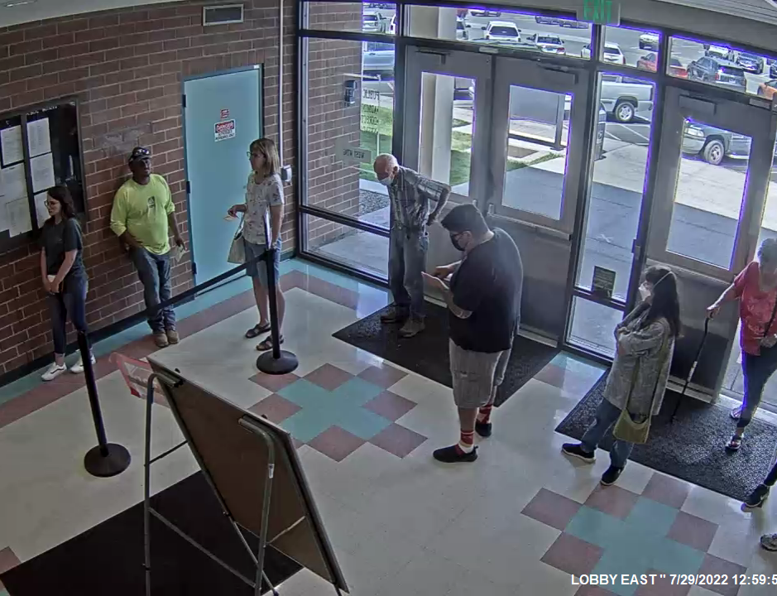
Why are the Carson City upgrades needed?
The self-service kiosk inside the Carson City DMV has been moved several times in the customer lobby.
The size of the kiosk and the customers lining up create traffic flow bottlenecks.
The DMV would like to install a different kind of kiosk, one which is external to the facility, like the setup at the new South Reno office.
This CIP request is being submitted to construct a secure room in the main East Wing vestibule which backs onto the customer-facing kiosk terminal. This room will require a lockable door, fire alarm detection, security camera, ventilation, lighting, electrical power and data.
The current kiosk is only available during normal business hours. The new one would be available any time of the day including weekends. Wait lines inside would be reduced.

Slide 24
Construct Secure Parking Area for State-Owned Vehicles at the Flamingo DMV

Slide 25
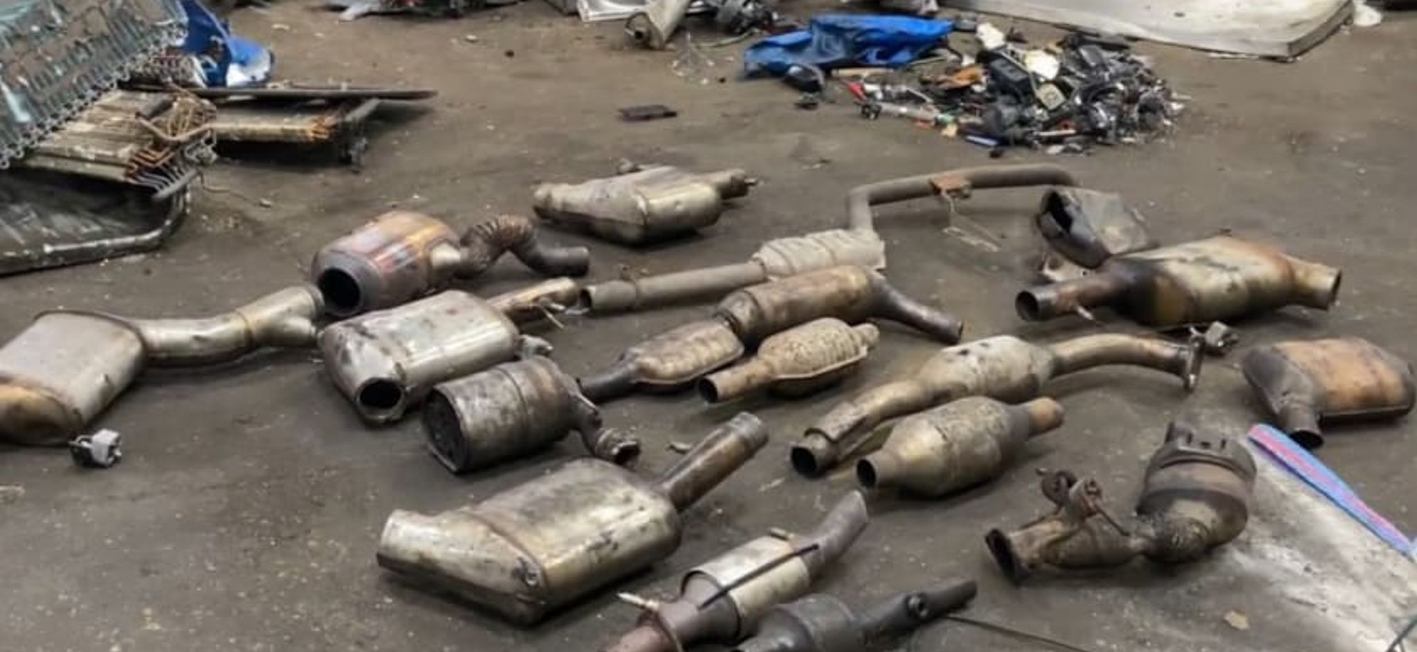
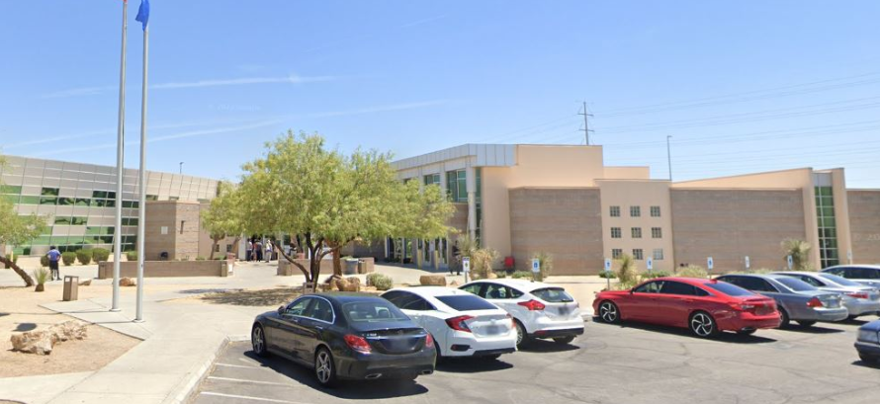
Why is a secure parking area needed at Flamingo DMV?
There is an increase in vehicle vandalism and theft of auto parts in the area.
By having a secure place to park State vehicles, there will be less impact on agency operations.
This project would construct a secure parking area for State-owned vehicles with security fencing, a paved parking pad, a secure badge-access gate, EV charging points and improved lighting.

Slide 26
Install Emergency Generator at Carson City License Plate Factory

Slide 27
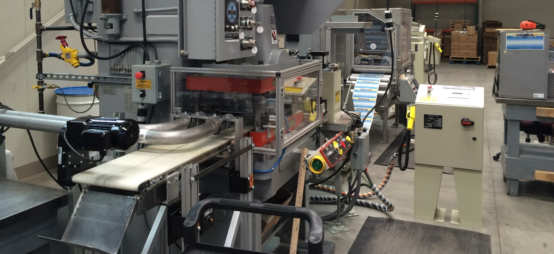
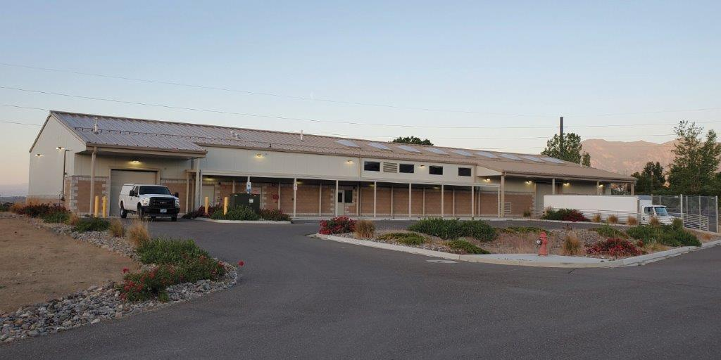
Why is a generator needed at the License Plate Factory?
There is a need for a 100kW standby generator to keep the statewide license plate factory production line operating because of unstable utility power in the area, which is due to the solar panel array operating at the adjacent prison.
There have been several instances where power outages have caused the early closure of the license plate factory resulting in lost productivity, customer delays and upset prison laborers.
This project would ensure continuous operations for the license plate factory that is struggling to produce plates in a timely manner for the entire state.

Slide 28
Thank you
Notes:
Thank you for your time today and we can take any questions at this point.

